Slide 1
Rockfall Risk:
Determining the expected costs of rockfall consequences
(Lawrence Rwodzi )

Slide 2
Objectives
Discuss a risk cost approach to stope support design
Describe a methodology to quantify the expected cost of rockfall consequences in stopes
Show how the methodology is applied in the risk cost approach through use of a case study

Slide 3
Current design practice
Current design
Empirical
Widely understood and applied.
Technical based
Current design
Empirical
Gap
Measurable milestones
Integrated mine planning
Acceptable risk
Widely understood and applied.
Risk analysis
Technical based

Slide 4
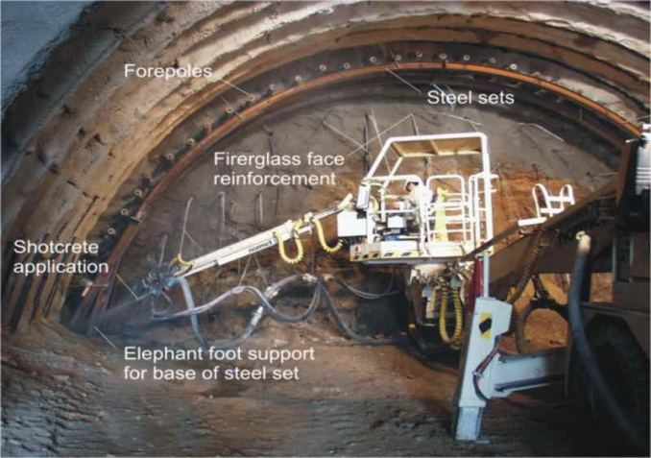
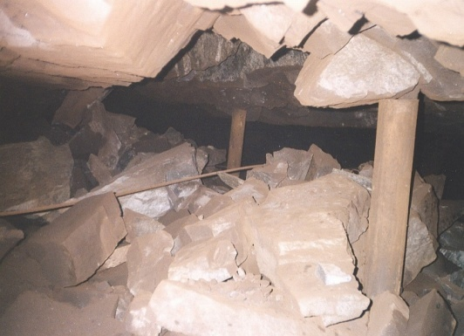
Risk-Cost Approach
High
Total Cost
Cost
Optimum
Annual Cost
of
Risk Control
Expected Annual
Cost of
Consequences
Low
Low
High
Risk

Slide 5
Determination of cost of consequences per rockfall
Equipment damage cost
Excavation damage cost
Cost of consequences per rockfall
Personnel injury cost
Excavation damage cost
Cost of consequences per rockfall

Slide 6
Excavation Damage Cost
Production Loss
Reserve Loss
Sweepings Loss
Stope damage
Dilution
Re-supporting

Slide 7
Determination of Costs: Inputs
General mining parameters
Support standards and costs
Rockfall data
Financial data
Direction of
Mining

Slide 8
Typical Mine Costs
Loss | Formulae | Cost
Production Loss | Revenue/t – Processing Cost/t – Cost of consumables/t | R1,127/t
Sweepings | ((Revenue – Processing cost) ÷ area mined) x density correction x Height correction | R727/m²
Re-supporting | Support cost per m² | R35.98/m²
Dilution | Processing Cost ÷ tonnes mined | R96.67/t

Slide 9

Small Rockfalls
Area to be re-supported
Dilution Cost
Re-supporting Cost (Material)
Production Loss
  Cleaning-up and re-supporting
Rockfall

Slide 10

Large Rockfalls
Area of Sweepings Lost
Sweepings Profit Loss
Pillar
Reserve Loss
Production Loss
  Re-establishing
  Redeployment
Rockfall

Slide 11
Determination of Expected Annual Cost of Consequences
Excavation damage cost
Cost per Rockfall
∑
(
Annual
Frequency
of Rockfalls
)
Expected Annual
Cost
X
=

Slide 12
Annual Frequency of Rockfalls
Joint Parameters
Support design
JBlock
Annual frequency of rockfalls distribution
Rockfall Database
Actual Rockfall dimensions

Slide 13
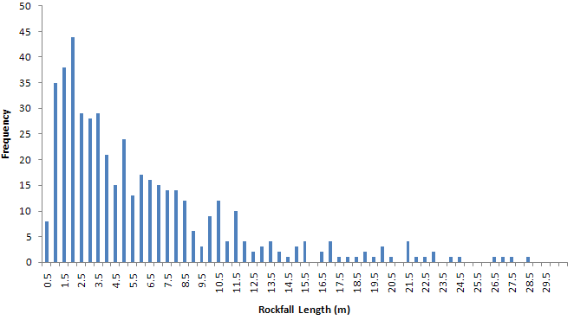
Annual Frequency of rockfalls distribution

Slide 14
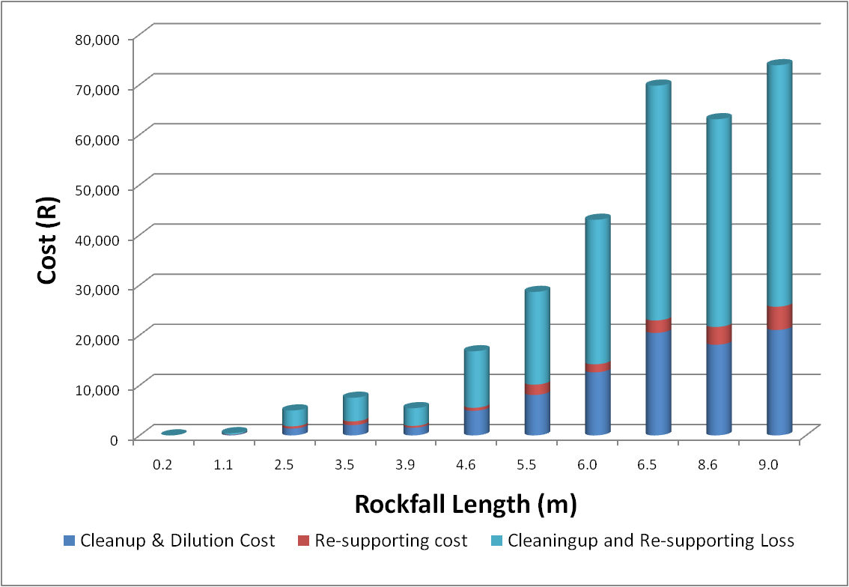
Cost per rockfall – Small rockfalls

Slide 15
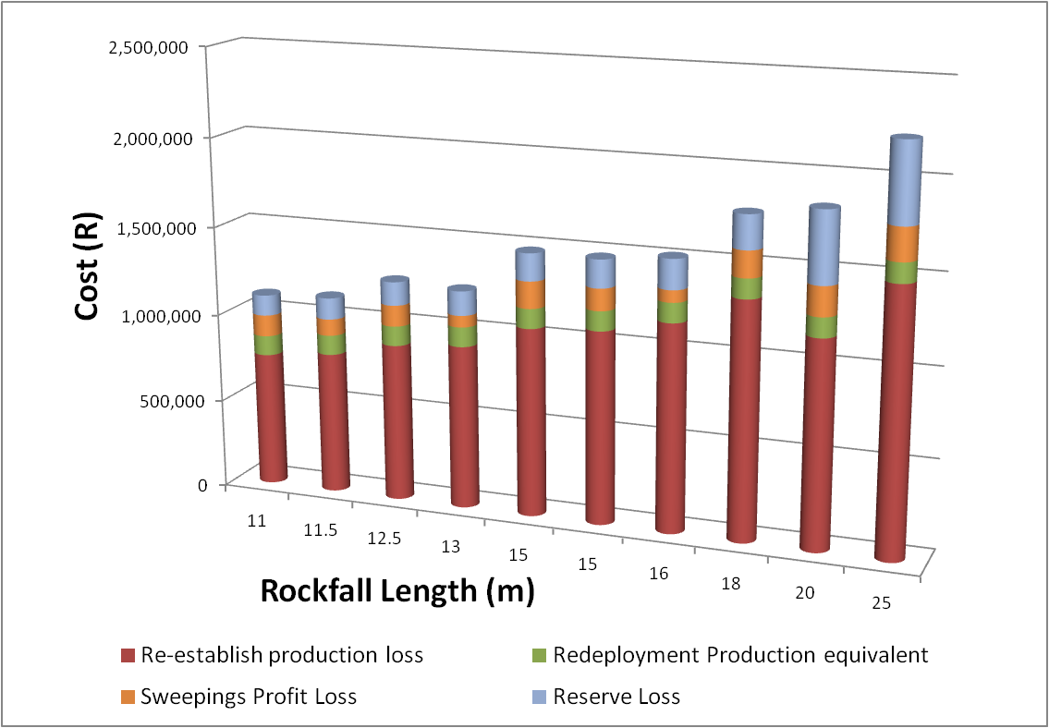
Cost per rockfall – Large rockfalls

Slide 16
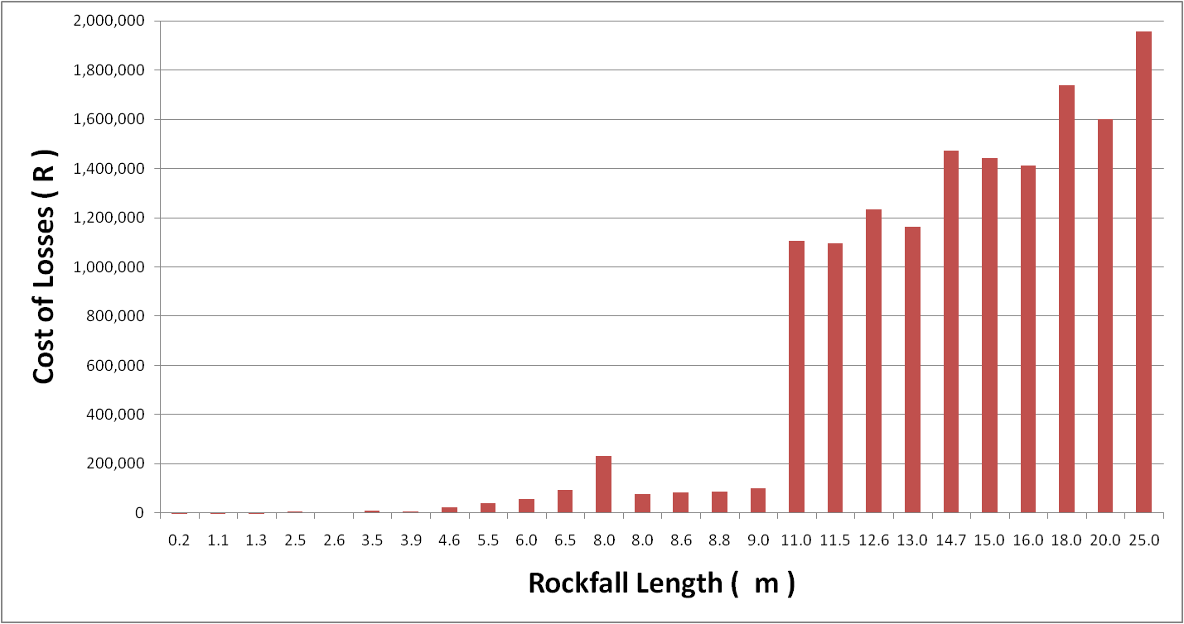
Cost per rockfall – All sizes
R1,233,161
R43,0232
R445

Slide 17
Expected Annual Cost of Consequences
Excavation damage cost
Cost per Rockfall
∑
(
Annual
Frequency
of Rockfalls
)
Expected Annual
Cost
X
=

Slide 18
Risk-Cost Result
High
Total Cost
Case Study
Cost
Optimum
Expected annual
cost of
consequences
Annual Cost
of
Risk Control
R11,711,806
Low
Low
High
Risk
Adapted from D. Viner, 2002

Slide 19
The cost of rockfall consequences
has been quantified and implemented
in design!!!!!
Best bang for your buck!!!
SO WHAT?
Economic Optimisation of support!!!

