Slide 1
Use of Joint Trace Plots to Evaluate Stability of Mining Excavations
Edgar Nezomba

Slide 2
Overview of Joint Trace Method
Joint data collection
Joint sets definition
Excavation geometry
Joint trace plots
Slopes Application
Block Analysis

Slide 3
Application of Joint Trace Plots
Jointed hard rocks
Shallow excavations
Low stress or destressed deep level conditions

Slide 4
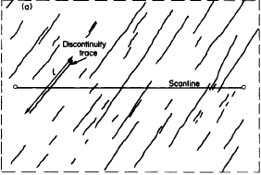
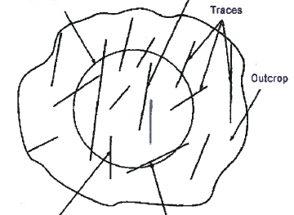
Joint Data Collection
Scanline mapping
Area or Cell mapping
Priest and Hudson, 1981
Zhang and Einstein, 1998

Slide 5
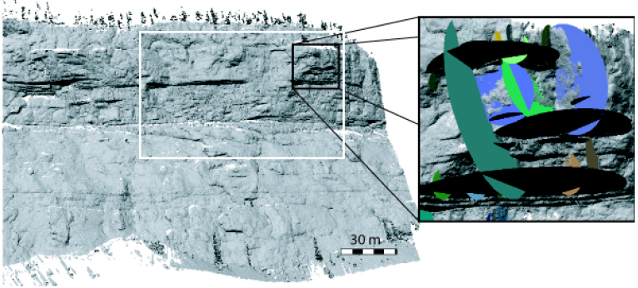
Photogrammetric Mapping
Sturzenegger and Stead, 2009

Slide 6
Sampling Bias
Orientation
Truncation
Censoring
Length

Slide 7
Joint Properties Required
Orientation i.e. dip and dip direction
Spacing
Length
Joint strength parameters
Joints are assumed to be planar

Slide 8
Observed Joint Properties
Property | Distribution
Orientation | Normal
Length | Lognormal
Spacing | Lognormal
Barton, 1976
Kulatilake and Wu, 1984
Gumede and Stacey, 2007
Joint set | Dip |  | Dip direction |  | Spacing | Length
 | µ | σ | µ | σ | µ | µ | σ
1 | 80 | 5 | 162 | 10 | 0.3 | 7 | 3
2 | 70 | 5 | 22 | 10 | 0.4 | 4 | 2
3 | 22 | 5 | 286 | 10 | 6 | 1.25 | 0.75
4 | 66 | 5 | 184 | 10 | 2 | 6 | 2

Slide 9
Steps in Joint Trace Simulation
Select Simulation Space
Generate Random Numbers
Produce Coordinates of the Trace and Plot them in 2D

Slide 10
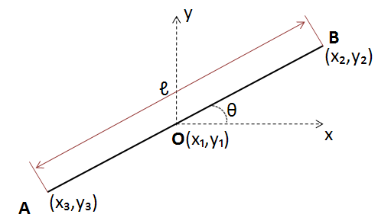
2D Joint Trace

Slide 11
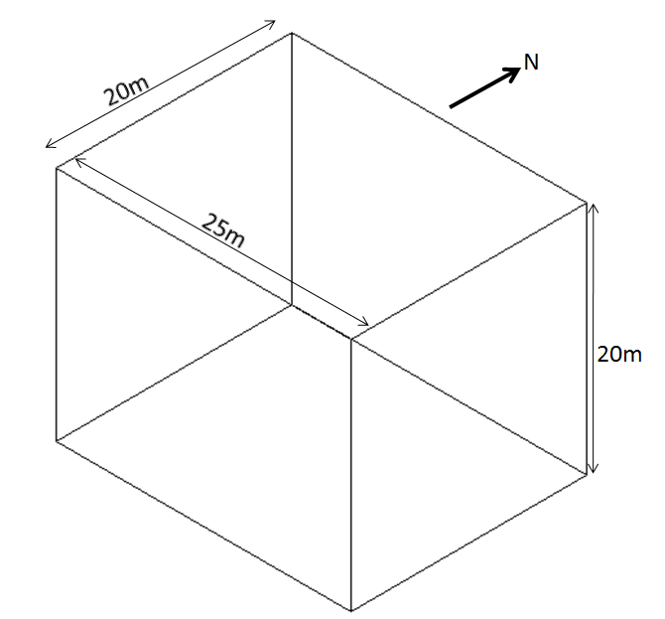
Excavation Geometry

Slide 12
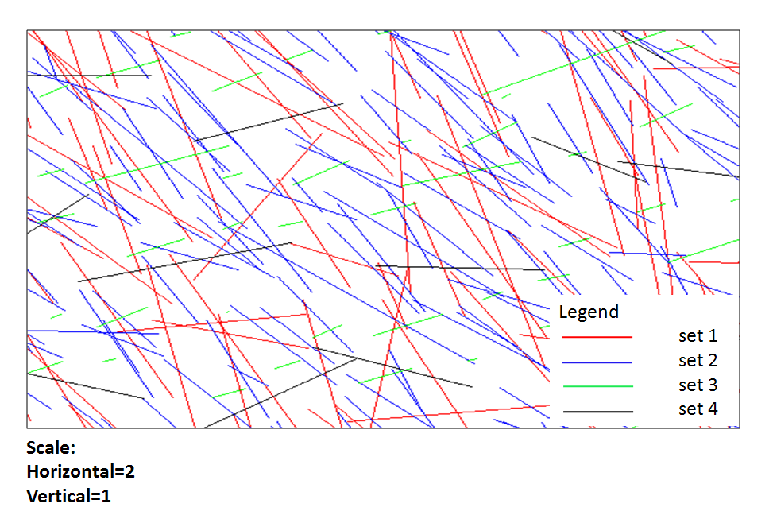
Joint trace plot

Slide 13
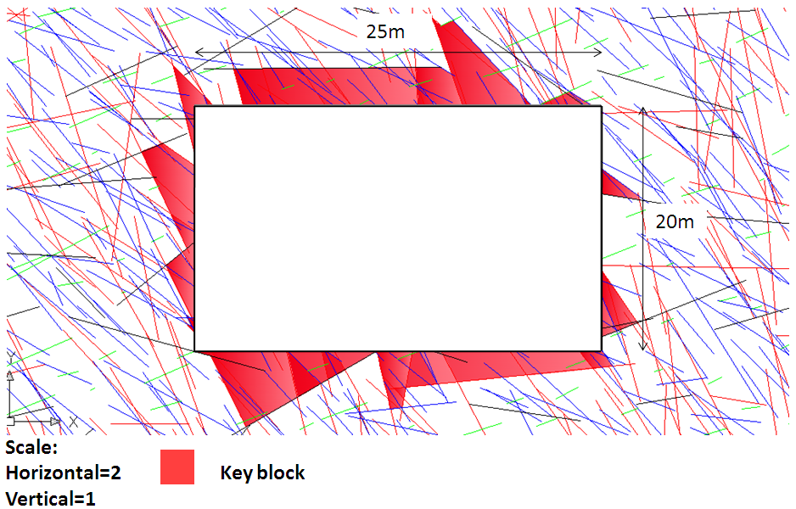
Plan View

Slide 14
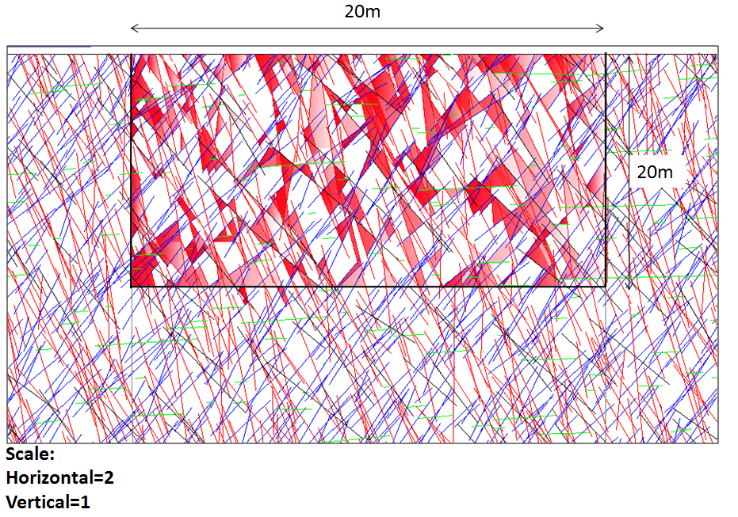
West Face

Slide 15
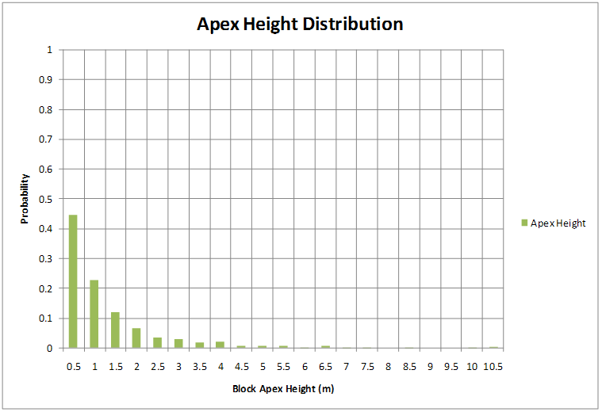
Key Block Apex Heights

Slide 16
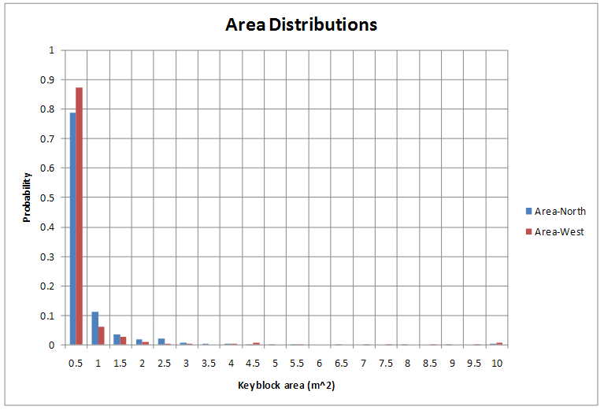
Key Block Face Areas

Slide 17
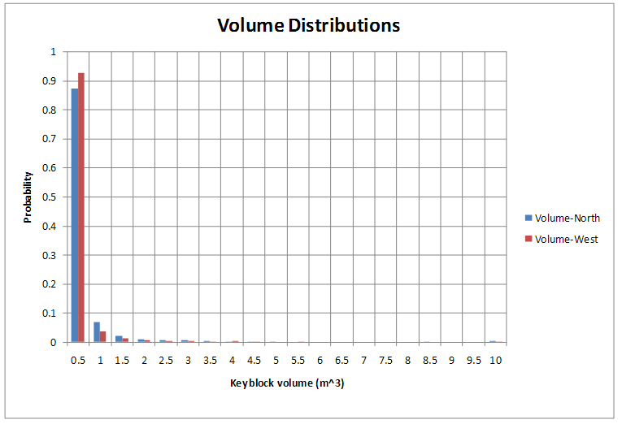
Key Block Volumes

Slide 18
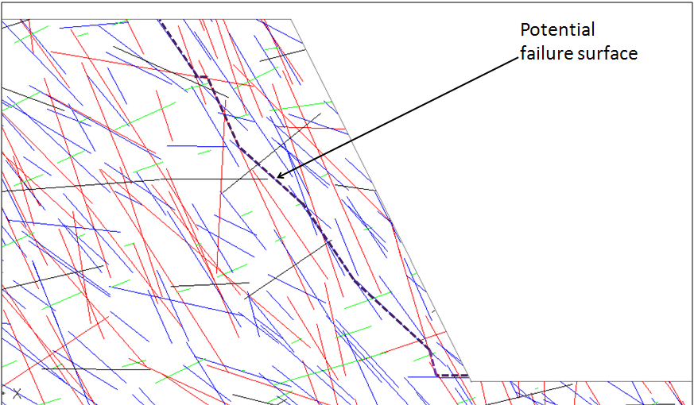
Application to Slopes

Slide 19
Conclusions
Visualise traces and compare with reality
Potential failure surface prediction
Analyse all block size ranges
Applicable in support design analysis
It broadens understanding of rock mass

Slide 20
Recommendations
Joint data collection in 3 orthogonal faces where possible
Emphasis on precision in data collection
Need for automation

Slide 21
Questions!

