Slide 1

ANNUAL GENERAL MEETING
THURSDAY
29 AUGUST 2024
VENUE: JOHANNESBURG COUNTRY CLUB
TIME: 09h00 – 14h00

Slide 2

SANIRE AGM Programme
Agenda | Portfolio
Arrival | Prudence Ntumelang
Safety Brief | Country Club
Welcome by the President | Kevin Le Bron
Apologies | Kevin Le Bron
Reflecting on the past year | Kevin Le Bron
Obituaries | Kevin Le Bron
Membership | Glorious Nkosi
Treasury | Sifiso Mashile
Break and Tea
Education Theory | Petrie Wessels
Education RE Prac | Thandile Dlokweni
Education SCO Prac | Rofhiwa Phadagi
Organisational Liasion | Jeanne Walls
ISRM | Jannie Maritz
Branch Feedback | Lizelle Prinsloo
General | Kevin Le Bron
Vote of thanks by President | Kevin Le Bron
Lunch

Slide 3
SANIRE COUNCIL

Slide 4
Portfolio | Portfolio Holder 2022/2023 | Portfolio Holder
 |  | 2023/2025
President / Events and Sponsorship | Lizelle Prinsloo | Kevin Le Bron
Past President | Paul Couto/Jannie Maritz | Lizelle Prinsloo
Vice President | Kevin Le Bron | Obakeng Rakumakoe
Treasurer | Sifiso Mashile | Sifiso Mashile
Administrator / Events | Mbalenhle Buthelezi | Mbalenhle Buthelezi / Prudence Ntumelang
Membership | Zwelinzima Thebethe | Glorious Nkosi
Social media, Newsletter, Awards | Thovhedzo Gcuda | Pearl Mosiane
Education, Minerals Council Exams Best Performance Awards | Petrie Wessels | Petrie Wessels
Future Education | Jannie Maritz | Jannie Maritz
Rock Engineering Practical Exams | Kevin le Bron | Thandile Dlokweni
Strata Control Officer Practical Exams | Rofhiwa Phadagi | Rofhiwa Phadagi
ISRM | Dr. Michael Du Plessis | Jannie Maritz
Organisational Liaison | Obakeng Rakumakoe | Jeanne Walls

Slide 5
Vision:
To actively promote the South African Rock Engineering Profession.
Values:
Honesty
Integrity
Professionalism
Accountability
Transparency
Mission:
SANIRE promotes the advancement of the Rock Engineering discipline by encouraging and promoting:
Interest and the development of education in Rock Engineering
Professional practice and high ethical standards
Networking, collaboration and information exchange
Research areas

Slide 6
HIGHLIGHTS

Slide 7
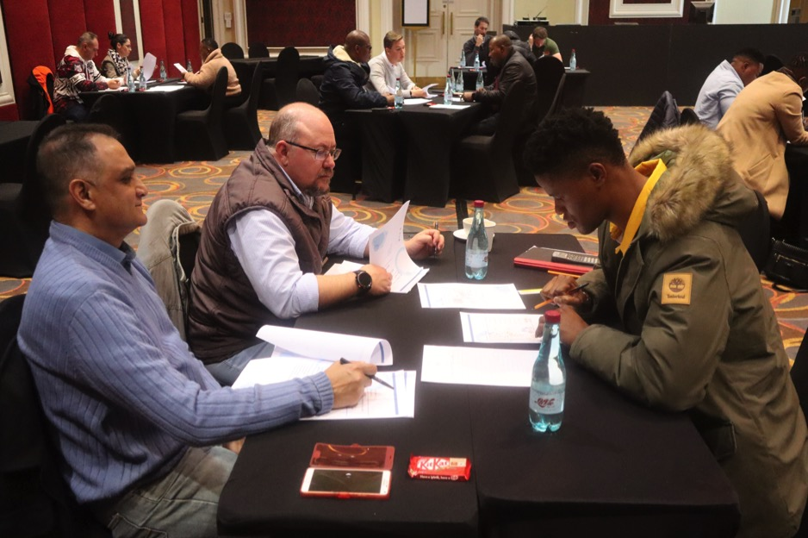
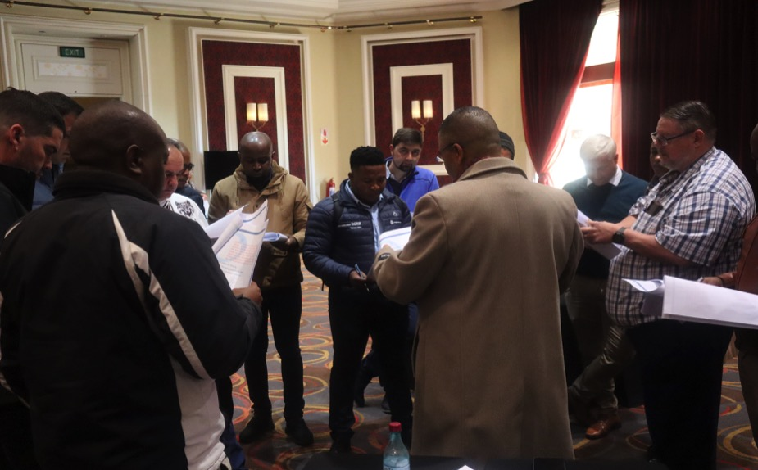
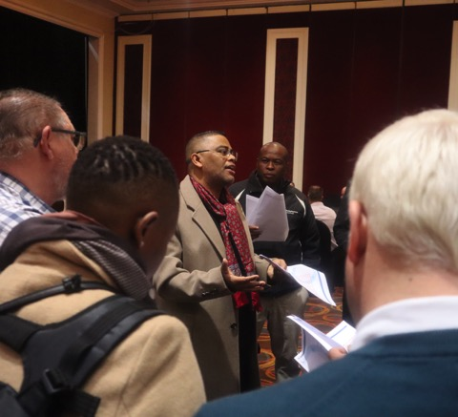
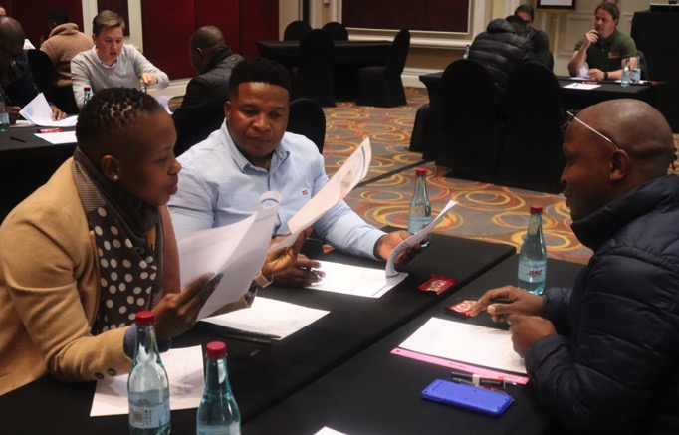
Rock Mechanics Practical Exams
2024

Slide 8
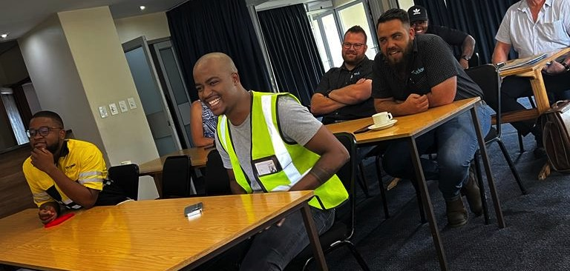
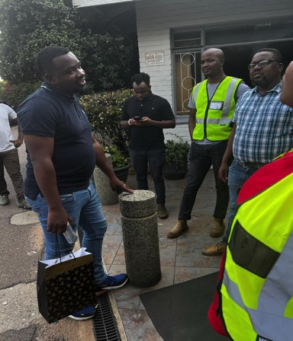
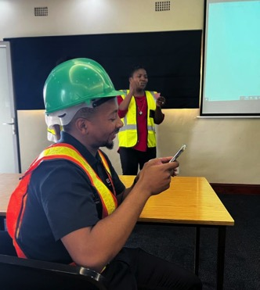

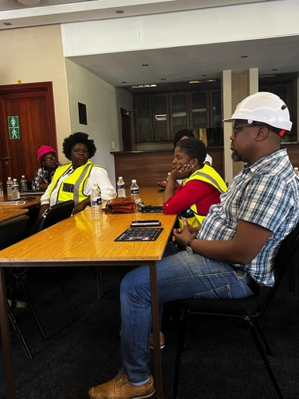
Coalfields Branch Meeting 2024
held in Secunda (Lake Umuzi)

Slide 9
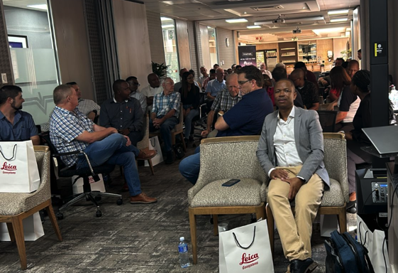
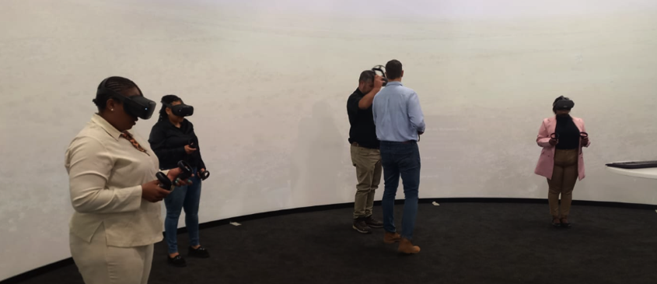

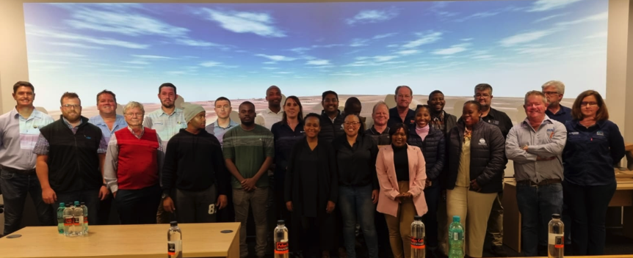
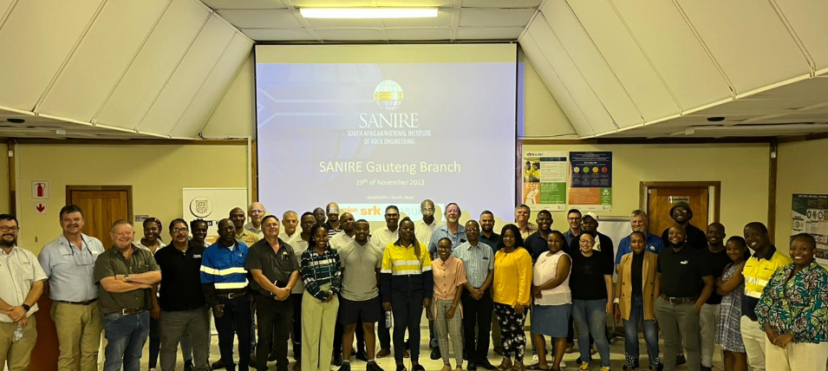
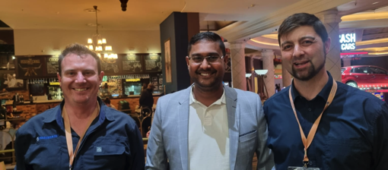
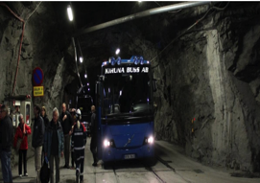
Gauteng Branch Meetings 2024

Slide 10

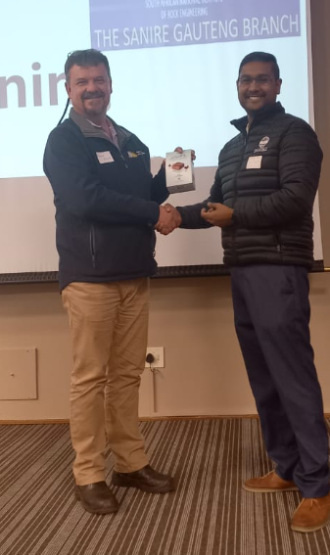
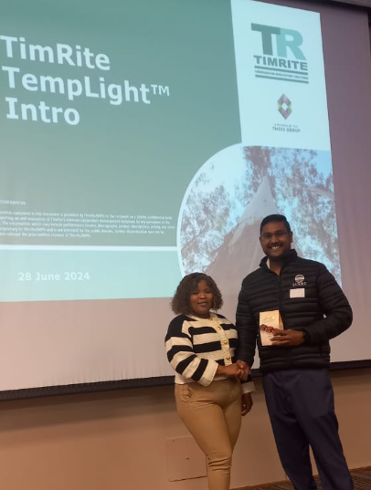
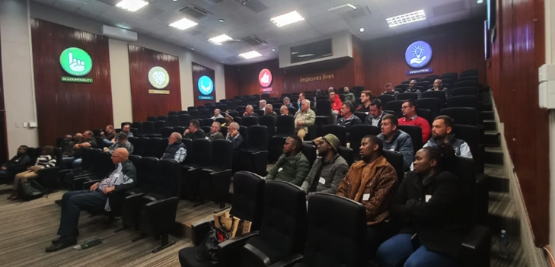
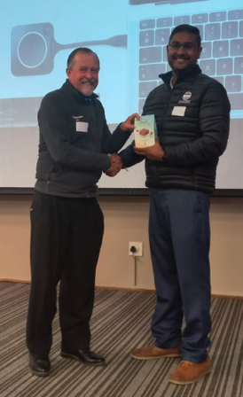
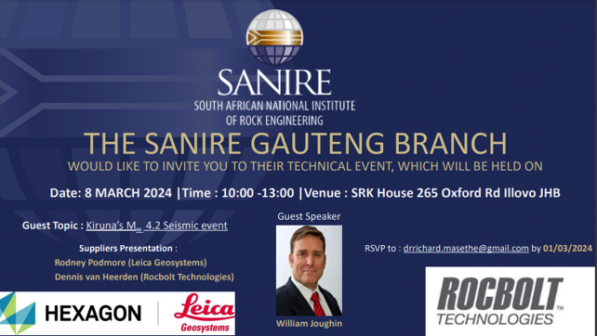

Slide 11
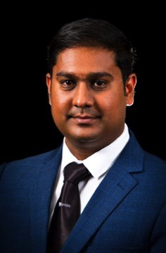
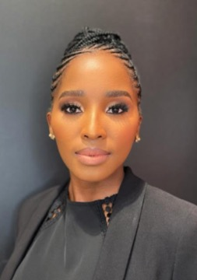
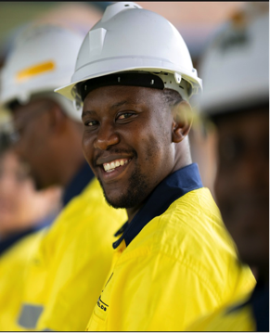
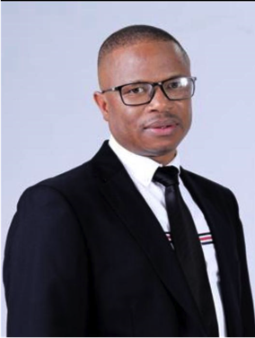
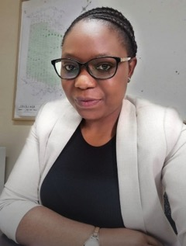
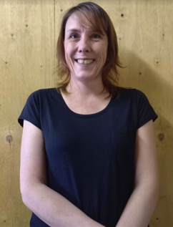
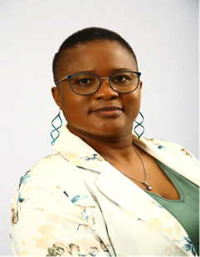
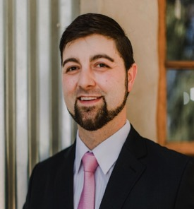
Gauteng Branch Committee
Ohveshlan Pillay
Chairperson
Phumza Banjwa
Vice Chairperson
Rabele Mokone
Treasurer
Dr Richard Masethe
Secretary
Yolanda Chambati
Education & Exams
Katinka Cartes
Supplier Representative
Fungai Kwangwari
Events Coordinator
Ross Van Heerden
Supporting Role

Slide 12
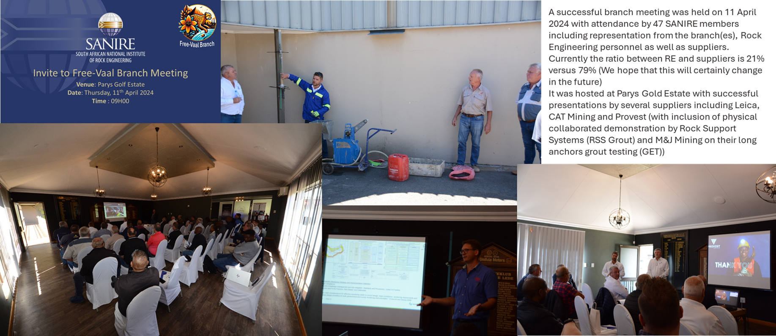
Free-Vaal Branch Meeting 2024

Slide 13
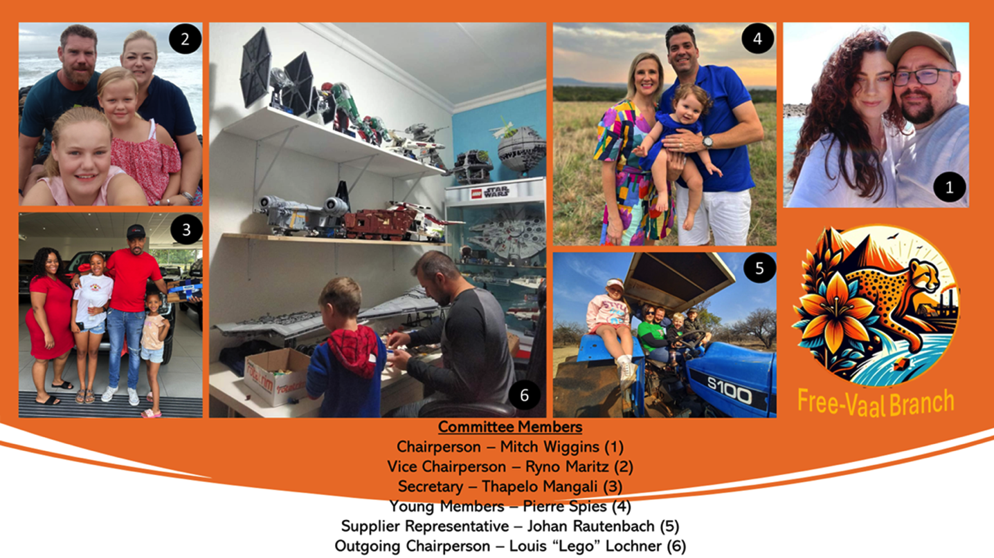
Free-Vaal Branch Committee

Slide 14
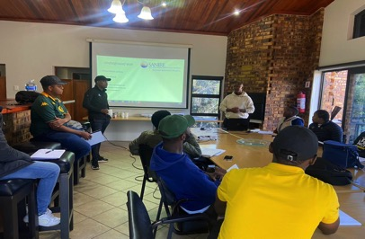

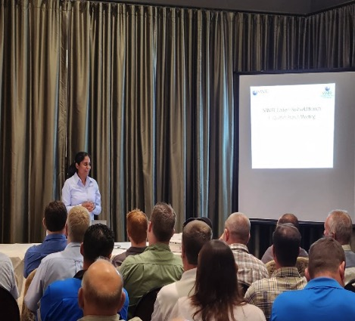
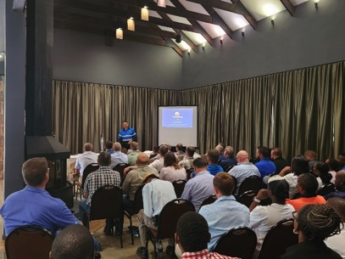
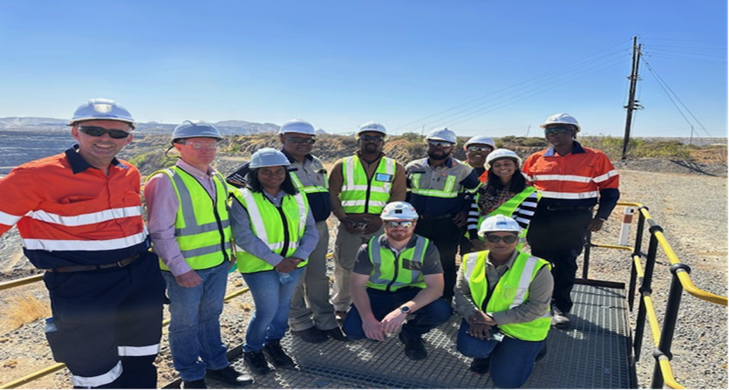
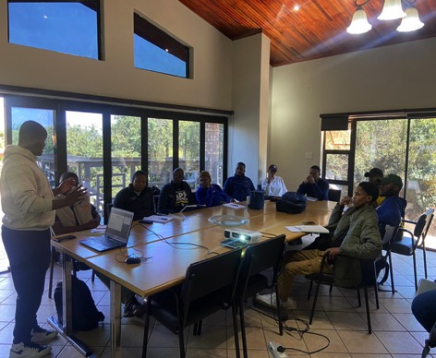
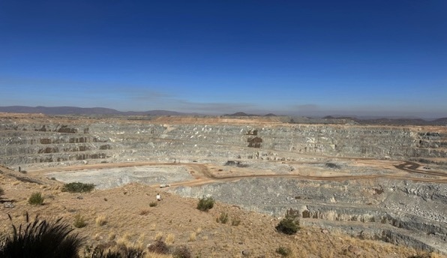
Eastern Bushveld Branch Meetings 2024

Slide 15
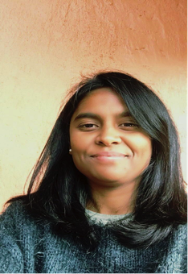
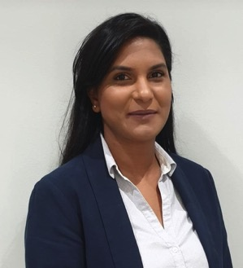
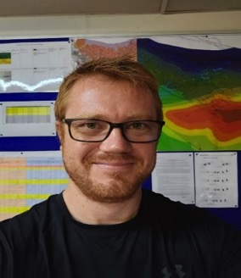
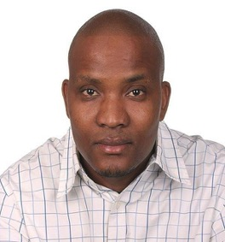
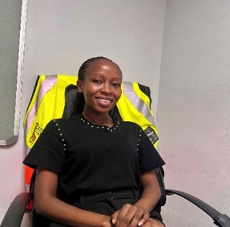
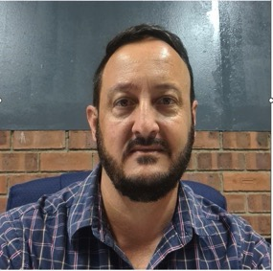
Eastern Bushveld Branch Committee
Easavani Wessels
Chairperson
Narisha Siriram
Vice Chairperson
Gideon van der Westhuizen
Treasurer
Obed Tsetsewa
Administrator
Vhutshilo Nemalili
Youth Development Rep.
Chris Brink
Supplier Representative

Slide 16

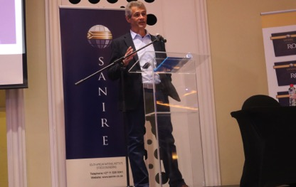
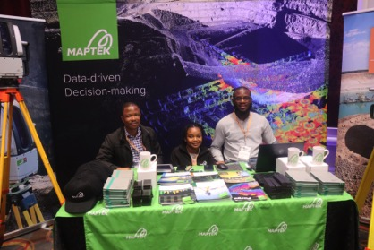
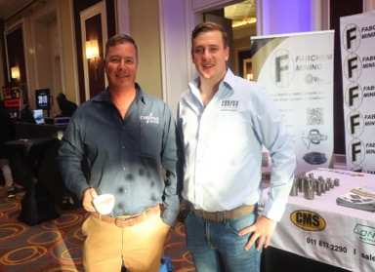
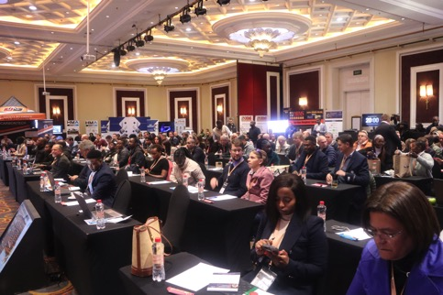
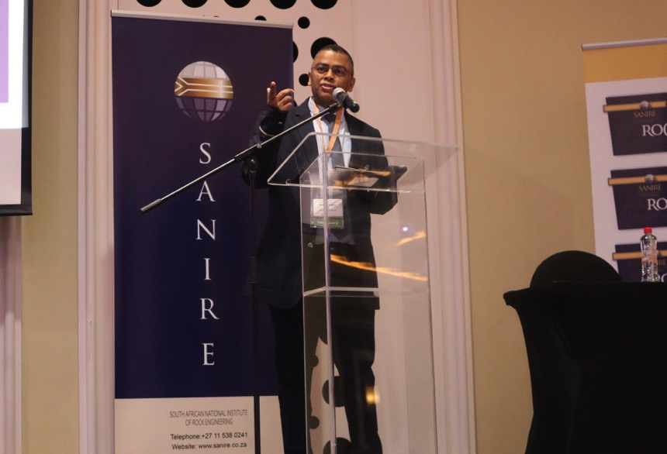
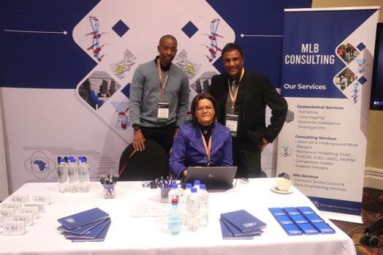
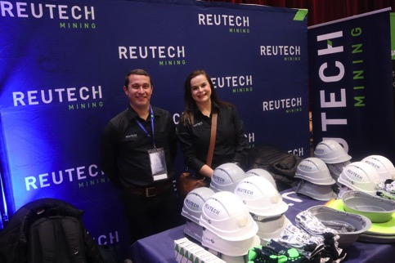
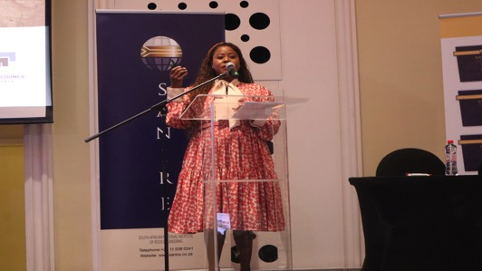
SANIRE SYMPOSIUM 2024

Slide 17

SANIRE SYMPOSIUM 2024
THANK YOU TO ALL THE SPONSORS

Slide 18
MEMBERSHIP
Glorious Nkosi

Slide 19
AGENDA
Membership Statistics
Statistics Per Category
Statistics Per Branch Ratio
Statistics Per Gender
Membership Transfers Work 2023/2024
Membership Changes to the Constitution
My Membership Launch and Website Upgrade/Updates
Introduction to the SANIRE Blazer and Recognition Pins
Conclusions

Slide 20
1. MEMBERSHIP STATISTICS

Slide 21
2. STATISTICS PER CATEGORY

Slide 22
3. STATISTICS PER BRANCH RATIO

Slide 23
4. STATISTICS PER AGE & GENDER

Slide 24
5. MEMBERSHIP TRANSFERS WORK (2023/2024)
Ass-Corp Mem

Slide 25
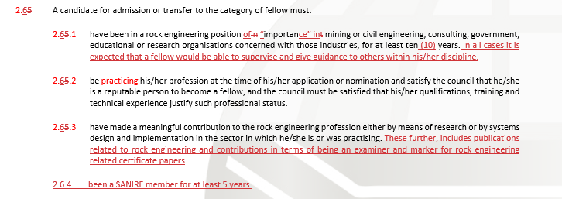
6. MEMBERSHIP CHANGES TO THE CONSTITUTION
Updating of membership Fellow transfer definitions
Updating of interns as part of the Student category

Slide 26
7. MY MEMBERSHIP LAUNCH
AND WEBSITE UPGRADE
Apply for Membership
Manage your Contact Details
Download your Membership Certificate and Confirmation Letter
Pay your Membership Fees
Register for SANIRE Events
Access to ISRM
Shop Online (COMING SOON…)

Slide 27






MY MEMBERSHIP LAUNCH
AND WEBSITE UPGRADE
New Applicates

Slide 28




MY MEMBERSHIP LAUNCH
AND WEBSITE UPGRADE
Active Members

Slide 29

NOT A MEMBER YET ???
APPLY FOR MEMBERSHIP

Slide 30



8. INTRODUCTION TO THE SANIRE BLAZER AND RECOGNITION PINS
SANIRE Blazer
Blazer Pin
Tie

Slide 31
9. CONCLUSIONS
We Are Here To Serve You !!!!!
Any queries or improvements regarding Membership may be forwarded to Prudence & Glorious.
Let’s take ownership of SANIRE ☺….

Slide 32
Treasury
Sifiso Mashile

Slide 33
Treasury: General Overview
FY2023/2024 made a marginal surplus of R98 826 (Main Branch)
FY2023/2024 has been concluded subject to an independent audit process.
Hence, FY2024/2025 has commenced on the 01st of July 2024.
MPAS to SAIMM Journey.
Financials Deep Dive
New Management Systems & VAT Registration

Slide 34

Financial Procedure and Membership Fees…
REMINDER
SANIRE Constitution Extract…

Slide 35
Sequence of Events:
Transition from MPAS to SAIMM
March 2024:
Transition to SAIMM
Membership database cleaned
SARS Tax Cert obtained
Pastel to SAGE
New Systems introduced
Jan 2024:
MPAS Contract not renewed
Outstanding Membership fees suspensions
2023:
Changes in Staff at MPAS
Poor Membership fees rec
Very Low Bank Balances
Tax clearance Cert challenges
2022:
Change in MPAS Accounting Services

Slide 36
Treasury: General Overview
 |  | Closing Balance | Actual | Closing Balance | Comments
Assets |  | FY2022/2023 | FY 2023/2024 | FY 2023/2024
 | Inventory | R 108 230 | (R10 600) | R 97 630 | Sold Rock Engineering books
 | Accounts Receivable | R 527 919 | R 358 213 | R 886 132 | Largely from Membership fees (including historical)
 | Current Bank Account | R 336 965 | (R 34 342) | R 302 623 | Transactional account
 | Savings Bank Account | R 912 968 | R 8 778 | R 921 745 | Investment Account
 | Accounts Payable- Suppliers | R123 347 | R 85 491 | R 208 838

Slide 37
FINANCIALS 2023/2024
-Income

Slide 38

FY2023/2024: Income
BUDGET
ACTUAL
SANIRE INCOME SUMMARY | FY 2023/2024
SANIRE National Branch | R1 542 692
Branches | R427 763
Total Income | R1 985 149
50%

Slide 39



FY2023/2024: Fees Recovery
FY 2023/2024 Membership Overall Recovery Rate = 48%

Slide 40
FINANCIALS 2023/2024
-Expenses

Slide 41


FY2023/2024: Expenses
BUDGET
ACTUAL
48%

Slide 42
FINANCIALS 2023/2024
-Branches

Slide 43
FY 2023/2024: SANIRE BRANCHES
 | SANIRE Branches Financial FY 2023/2024
 | Opening Balance (July 2023) | Income | Expense | Shortfall/ Surplus | Closing Balance (June 2024)
Eastern Bushveld Branch | R 47 254 | R 220 000 | R 259 475 | (R 39 475) | R 7 779
Coal Fields Branch | R 2 896 | R19 300 | R11 150 | R 8 150 | R 11 046
Gauteng Branch | R 10 837 | R 25 500 | R 20 457 | R 5 043 | R15 880
Western Bushveld Branch | R 79 135 | R 59 000 | R 68 056 | (R 9 056) | R 70 079
Freeval Branch | R 49 846 | R 24 500 | R 27 085 | (R 2 585) | R47 261
Northern Cape Branch | R11 500 | R 94 157 | R 41 540 | R 52 617 | R 64 117
Totals |  | R 442 457 | R 427 763 | R14 694 | R216 162
All SANIRE Branches have positive bank balances

Slide 44
Membership Fees
FY2023/2024

Slide 45
SARS VAT REQUIREMENTS
The SANIRE Council received advice from SAIMM to register as a VAT Vendor in accordance with the VAT Act No. 89 of 1991.
This requirement applies to all public organizations with an annual turnover exceeding R1 million.
The Council has hired third-party services to facilitate the VAT registration process to ensure compliance with national laws.
VAT registration will lead to a 15% increase in membership fees.

Slide 46
Membership Fees 2023/2024
CATEGORY | Aug-24 | Current Membership Fee FY 2023/2024 (R) | New Membership Fee FY 2024/2025 (R) (Excluding VAT) | Income from Membership Fees New Fees
Associate Members | 550 | 1000 | 1300 | R 715 000
Members | 189 | 1000 | 1300 | R 245 700
Fellow Members | 15 | 1000 | 1300 | R 19 500
Retired Members | 13 | 300 | 300 | R 3 900
Correspondence Members (Foreign) | 0 | 1000 | 1300 | R -
Honorary Life Members | 4 | 0 | 0 | R -
Honorary Life Fellow Members | 17 | 0 | 0 | R -
Student Members | 8 | 0 | 0 | R -
TOTAL MEMBERS: | 796 |  |  | R 984 100
 | Recovery rate | @50% |  | R 492 050
VAT will be incorporated in to invoices as soon as SANIRE is registered with SARS

Slide 47
Membership Fees Benchmarking

Slide 48
BUDGET FY2023 / 2024

Slide 49
Budget FY2024/2025:
Expenses

Slide 50
Budget FY2023/2024: Income

Slide 51

Budget 2023/2024: Shortfall/ Surplus Analysis

Slide 52
EDUCATION – THEORY EXAMINATIONS
Petrie Wessels

Slide 53
Theory Examination

Slide 54
Theory Examination

Slide 55
Theory Examination

Slide 56
Theory Examination

Slide 57
Theory Examination

Slide 58
Theory Examination

Slide 59
Theory Examination

Slide 60
Theory Examination

Slide 61
Theory Examination

Slide 62
Theory Examination Results
October 2023 & May 2024

Slide 63
Certificates Issued

Slide 64

Future in Education

Slide 65
STRATA CONTROL PRACTICAL EXAMINATIONS
Rofhiwa Phadagi

Slide 66
Exam Results
30% overall pass rate
Coal branch had 0% pass rate.

Slide 67
Exam Results
47% overall pass rate
No branch with 0% pass rate
Open Pit exam not conducted in the period.

Slide 68
Exam Results
38% overall pass rate in the last year.
Pass rate increased by 17% in May 2024 compared to Oct 2023

Slide 69
STRATA CONTROL PRACTICAL EXAMS
CHALLENGES:
Challenges with availability of Examiners:
Two exam were redone
Tardiness with releasing of results from Examiners & Coordinator:
Improvement needed to release results within 3 weeks at the latest
PROPOSAL:
Amendment to SCO Guidelines:
Include SCO with 2 Papers to assist with exams. SCO must be paired with a Rock Engineer.

Slide 70
Rock Engineering Certificate
Practical Examinations
Thandile Dlokweni

Slide 71


Rock Engineering Certificates Issued in July 2024
A historic 40 x Candidates in the combined Planning and/or Portfolio Practical Exams for June/July 2024
Number of Tickets Issued – 7
3 MET
3 OPEN PIT
1 MASSIVE

Slide 72

June/July 2024 Practical Examination Results
PLANNING EXAMINATION
5/30 passes, 17% compared to 15%, Nov 2023
PORTFOLIO EXAMINATION
11/33 passes, 33% compared to 17%, Nov 2023
OVERALL PRACTICAL RESULTS
25% pass rate in recent exams
Slight improvement compared to 2023
Longstanding worrying trend since 2021

Slide 73

June/July 2024 Portfolio Examination Results
How is Competency Demonstrated?
Several outcomes must be achieved in 5 x Competency Areas
Competency areas 3, 4 and 5 constitute a combined 80% towards the overall Pass Mark
Portfolios generally do not meet expected levels of technical rock / geotechnical engineering content
Areas of concern may be a combination of
  Exam Preparedness
  Level of Appropriate Exposure
  Structured Development
  Employer Commitment / Support

Slide 74


June/July 2024 Portfolio Examination Results
Example: Competency Area 3: Level and Relevance of Technical Content, challenges include
  Problem Definition
  Techniques Used
  Correct Conclusions
  Appropriate Recommendations

Slide 75
Reflection from Portfolio Examinations
General
Continued Reluctance of Rock/Geotechnical Engineers to be Portfolio Examiners. SANIRE Council is reviewing measures to encourage more participation and recognition for the contribution of Examiners
Issues in the general aspects such as Problem Statements, Conclusions, and Recommendations indicate that mentors are not evaluating portfolios
Plagiarism remains a key risk and we rely on mentors to assist in this regard
No major complaints have been received from Candidates and Mentors. However, we welcome any advice in order to mitigate confusion or misunderstandings in future
June/July 2024 Examiners and Moderators will be reappointed for October/November Exams

Slide 76
Organisational Liaison

Slide 77
The status of the ISRM
Jannie Maritz, Vice-President: Africa

Slide 78
Nature of the ISRM
Founded in 1962, in Salzburg, by Prof. Leopold Müller
Non-profit scientific association
Field of activities: Rock mechanics and rock engineering:
“includes all studies of the
physical, mechanical, hydraulic, thermal, chemical and dynamic behaviour
of rocks and rock masses,
and engineering works in rock masses,
using appropriate knowledge of geology”
Applied to civil, mining and petroleum engineering works

Slide 79



Membership
Total: 9300 individual members belonging to 59 National Groups
The ISRM Council represents the National Groups

Slide 80

The ISRM Board 2023-2027
President: Seokwon Jeon Korea
VP Africa: Jannie Maritz S. Africa
VP Asia: Ki-bok Min R. Korea
VP Australasia: Qianbing Zhang Australia
VP Europe: Muriel Gasc France
VP N. America: Martin Grenon Canada
VP L. America: Esteban Hormazabal Paraguay
VP at Large: Kiyoshi Kishida Japan
VP at Large: Fengshou Zhang China
VP at Large: Miilorad Jovanovski N. Macedonia
Secret. General: Luís Lamas Portugal

Slide 81
Technical Commissions 2019-2023
  Coupled THMC Processes in Fractured Rock
  Crustal Stress and Earthquake
  Deep Mining
  Design Methodology
  Discontinuous Deformation Analysis - DDA
  Education
  Grouting
  New Commissions for 2023-2027 are now being approved by the Board

Slide 82



ISRM Suggested Methods for Testing
  All SMs available for free to ISRM members
  Several videos available on the ISRM website

Slide 83







Sponsored Conferences

Slide 84



Awards
  Müller Award
  Rocha Medal - best PhD
  ISRM Fellows
  Franklin Lecture
  John Hudson Rock Engineering Award
  Science and Technology Awards
    Science Achievement
    Technological Innovation
  Young Rock Engineer
  Best Paper Award
  Best Performing National Group Award
  Outstanding Commission Award

Slide 85








ISRM Book Series
  To promote the scientific output of the ISRM
  Coordinated by the ISRM
  Published by CRC Press

Slide 86


Courses and Online Lectures
  Online lectures broadcast every 3 months by renowned researchers and practitioners.

Slide 87



e-Newsletter and News Journal

Slide 88




Young Members Activities
ISRM Young Members’ Monthly Webinar Series
  To create a global network for ISRM young members to
  connect and to share knowledge, experience, and ideas.
  Young rock mechanics professionals are invited to join
  the talks or consider giving a talk.
Drilling competition
Student’s night
  Created by the Brazil NG.
  International RockBowl games take regularly place in ISRM conferences since 2015.

Slide 89
Early Career Forums
Financially supported by the ISRM Education Fund
  1st – AfriRock 2017, Cape Town
  2nd – Eurock 2018, St Petersburg
  3rd – ARMS 2018, Singapore
  4th – 14th Congress 2019, Foz do Iguaçu
  5th – Eurock 2021, Turin
  6th – ARMS 2021, Beijing
  7th – LARMS 2022, Asunción
  8th – 15th Congress 2023, Salzburg
  9th – ARMS 2024, New Delhi
Participants in the 1st Early Career Forum

Slide 90



New Website and YouTube channel
Website updated and upgraded with new facilities
  New graphical design
  Easier access to contents
  Responsive design for mobile phones and tablets
YouTube channel
  Streaming of live events organised by the ISRM
  Storage of videos
  Young members channel
  European rock mechanics debates

Slide 91


ISRM Digital Library
  Papers from ISRM sponsored conferences
  Available through Onepetro.org
  100 free downloads per year for ISRM members
  11,700 papers from 72 conferences (98,300 pages)

Slide 92

Technical Glossary
  1,000 words with 19 languages
  Translation in more languages under way

Slide 93




Technical Commissions 2019-2023
The ISRM promotes many activities announced on the ISRM Website or through and LinkedIn
ISRM YouTube channel
ISRM page
Look for @IntSocRockMec
add us to your X feed and don't miss any news.

Slide 94
GENERAL

Slide 95
Thank you

